Slide 1

Goa Institute of management
Group Members:
Astha Narain
Aviral Mehta

Slide 2
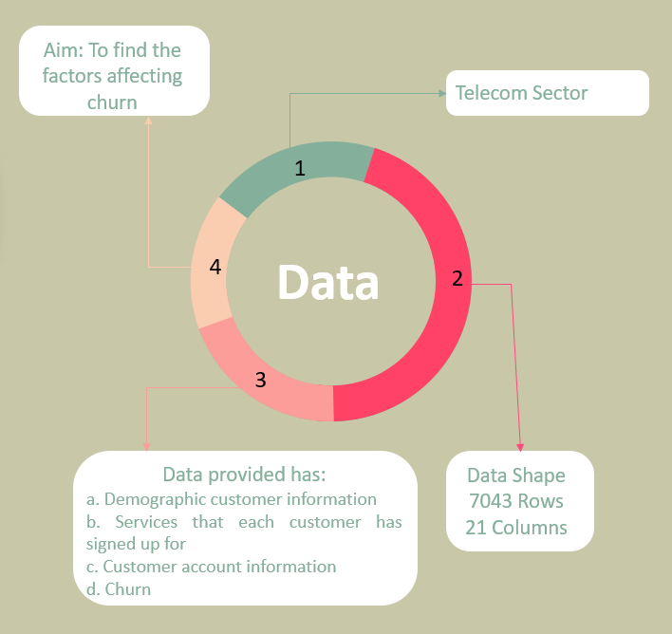
About Data

Slide 3
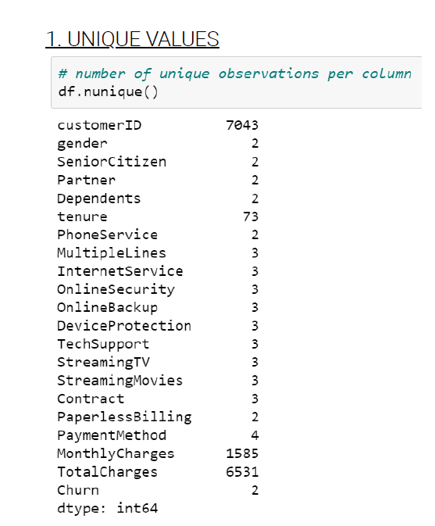
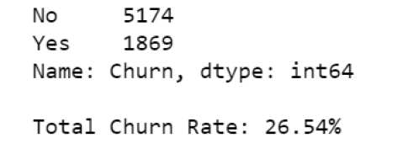
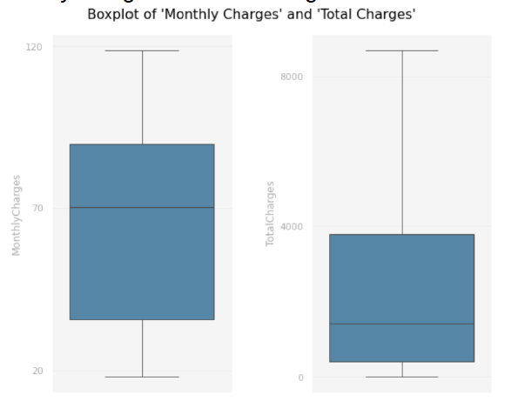
EDA
We didn't spot any outlier in any of the columns here are few boxplots MonthlyCharges nor TotalCharges.
We Observe that the churn rate is 26.5%, meaning that the quantity of "No" values is substantially higher than that of "Yes" values, which mean we have an imbalanced data
Observe that we have 21 features for 7043 clients. Among all features, 3 of them are numerical, 10 are categorical and the remaining can be considered binary. The feature 'customerID' represents a unique value for each row.

Slide 4
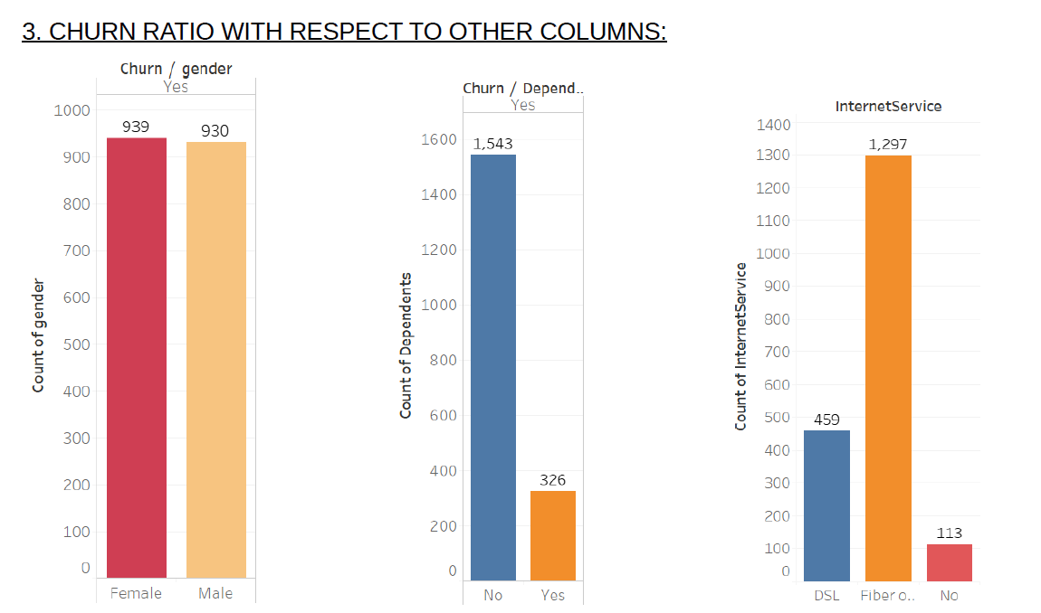
Looking at the example above, we can interpret that
Gender probably won't be a meaningful variable to the model, as the churn rate is quite similar for both male and female customers.
On the other hand, clients with dependents are less prone to stop doing business with the company.
As for internet service, customers with fiber optic plans are more likely to quit. Their churn rate is more than double that of DSL and no internet users.

Slide 5
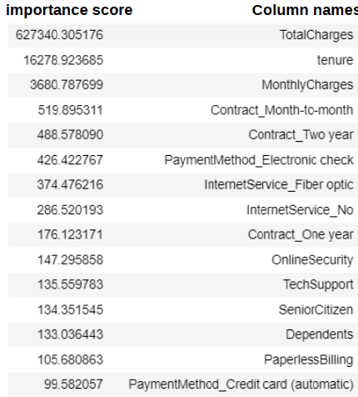
Feature Selection
We did churn modelling using algorithms like logistic regression and XGBoost and found out what are the columns which are the most important while finding the churn.
These are the primary factors on which 'çhurn' depends and based on it we have done our churn visualization.

